Slide 1

Movie Success Analysis
Finn Arffmann - Sanem Gingery - Parisha Gupta - John McNamara - Jackson Whited

Slide 2

We are aiming to answer questions pertaining to what some may call a “dying industry”...
?
What factors go into making the theatrical release of a movie successful?
Is a movie’s success based on how much money was put into its production?
Are certain genres more profitable than others?
?
?
?
?
?
?
?
?
Notes:
Our analysis is focused on the success of movies, and we formed our assumptions based on the following questions - what factors go into making a theatrical release successful, whether a movie’s success is based on it production cost, and if certain genres are more profitable than others.

Slide 3

Basis of Analysis
Hypothesis | Null Hypothesis
Higher production costs result in higher worldwide sales. | Higher production costs do not result in higher or lower worldwide sales.
There is a significant difference in profitability between movie genres. | There is no significant difference in profitability between movie genres.
There is a strong correlation between a movie’s opening weekend and worldwide sales. | There is no correlation between a movie’s opening weekend and worldwide sales.
Summer movies have higher opening weekend sales. | Summer movies do not have higher opening weekend sales compared to non-summer movies.
MPAA Rating significantly impacts worldwide sales. | There is no difference in worldwide sales when it comes to a movie’s MPAA rating.
Notes:
Based on these questions, we developed the following hypotheses and null hypothesis to test with our selected data sets. First, Jackson will shed some light on our data and clean up process, then we will discuss each hypothesis in detail.

Slide 4

Datasets Used
"Top 500 Movies by Production Budget" ¹
This dataset will include data surrounding:
- Production Cost
- Worldwide Sales
- Opening Weekend Sales
- Profit Margin (Worldwide Sales less Production Cost)
- Genre
- MPAA Rating
"IMDB Movies Dataset" ²
This dataset will include data surrounding:
- Release Date
- Duration
- Rating
1. https://www.kaggle.com/datasets/mitchellharrison/top-500-movies-budget
2. https://www.kaggle.com/datasets/amanbarthwal/imdb-movies-data

Slide 5

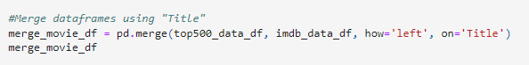
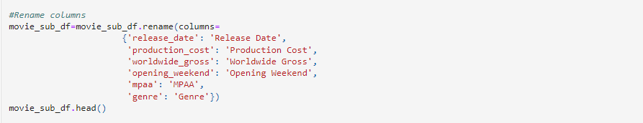
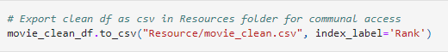
Data Clean-up
Merged our two dataframes using the “Title” column
Got rid of unused columns and renamed the remaining ones
Dropped rows with empty cells
Exported cleaned dataframe to CSV

Slide 6

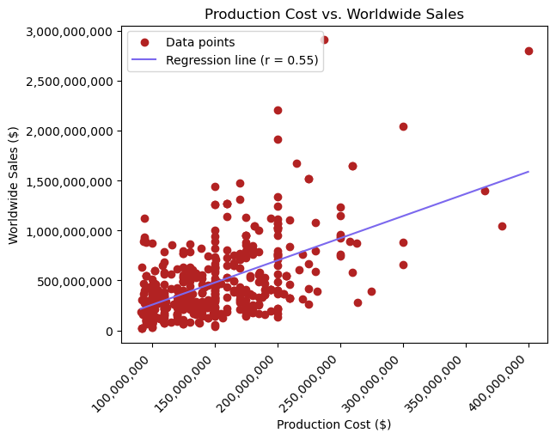
Production Costs vs. Worldwide Sales
H₀: Higher production costs do not result in higher or lower worldwide sales → REJECT
Worldwide sales increase as production costs increase.
r-value (.55) shows moderate correlation and p-value (3.29e-38)<.05 indicates stat. sig.
→ REJECT H₀
Notes:
r-value = 0.55 indicates moderate positive correlation
p-value = 3.29e-38 < .05 benchmark, meaning we reject the null hypothesis
While the correlation isn’t strong, we can say that worldwide sales tend to increase as production costs increase

Slide 7
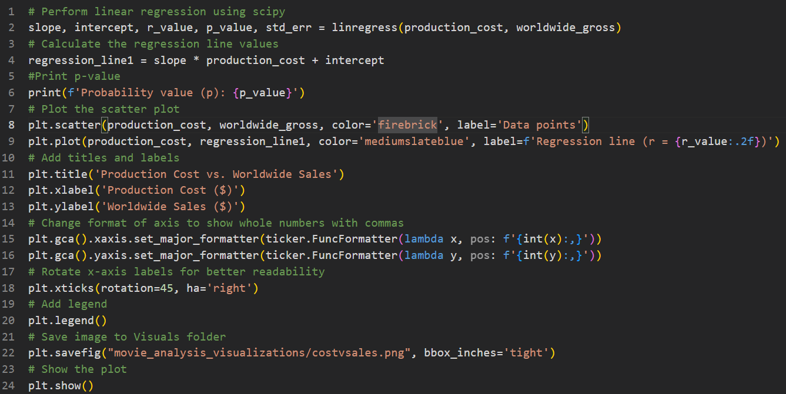
Production Costs vs. Worldwide Sales
CODE SNIPPET
Notes:
r-value = 0.55 indicates moderate positive correlation
p-value = 3.29e-38 < .05 benchmark, meaning we reject the null hypothesis
While the correlation isn’t strong, we can say that worldwide sales tend to increase as production costs increase

Slide 8

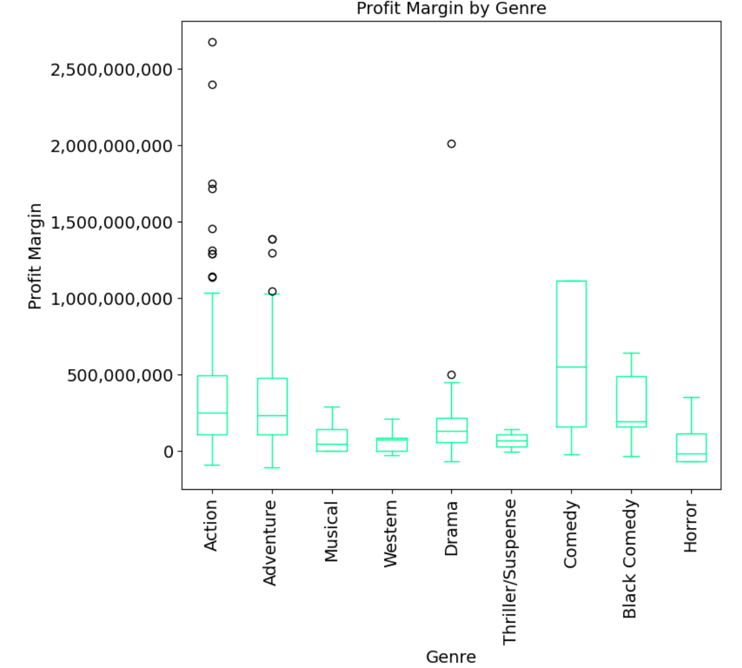
Profit Margin by Genre
H₀: There is no significant difference in profitability between movie genres→REJECT
There is a significant difference in profitability by genre
f-stat (2.75) exceeds critical value (1.938) and p-value (.005)<.05 indicate significant difference between genres and profitability
→ REJECT H₀
Notes:
We found there is a significant difference in profitability by genre, so we can reject our null hypothesis claiming there is no difference. This is supported by the F-Statistic exceeding the Critical Value and the P-Value being less than .05.

Slide 9
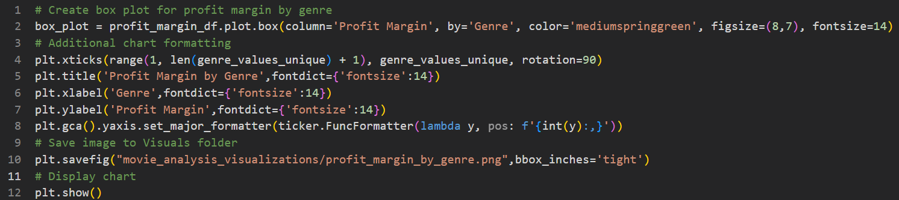
Profit Margin by Genre
CODE SNIPPET
Notes:
This code snipped shows steps for the histogram in the previous slide including creation, additional formatting, and saving the figure to a central folder in our repo

Slide 10
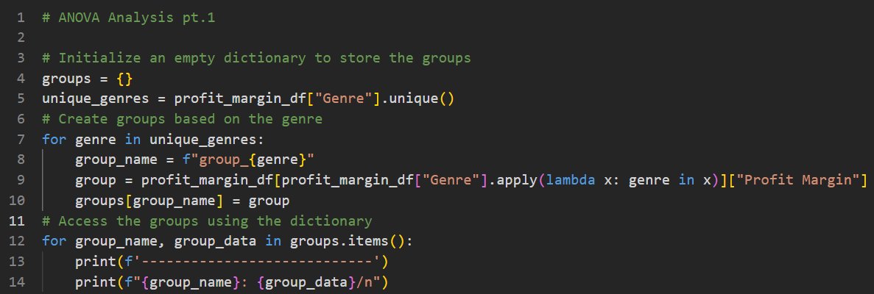
Profit Margin by Genre
CODE SNIPPET
Notes:
Here, we are performing an ANOVA analysis using a for loop to save each genre’s profit margins in a defined list for further calculation in the next slide

Slide 11
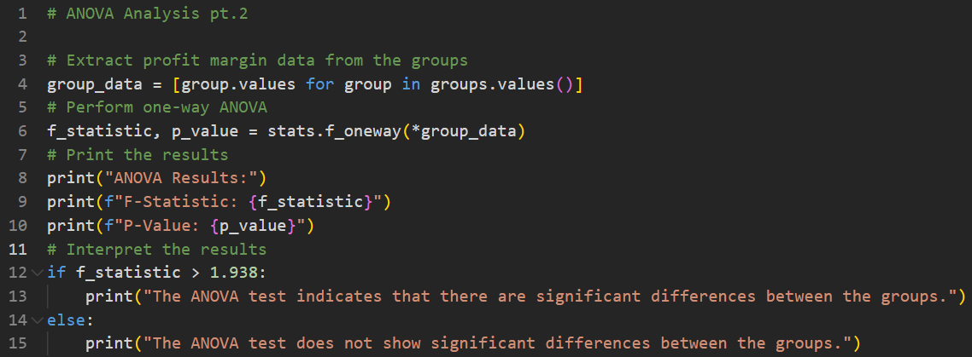
Profit Margin by Genre
CODE SNIPPET
Notes:
Lastly, we use stats.f_oneway to calculate the F-Statistic and P-Value for the total sample set in addition to interpreting the results

Slide 12

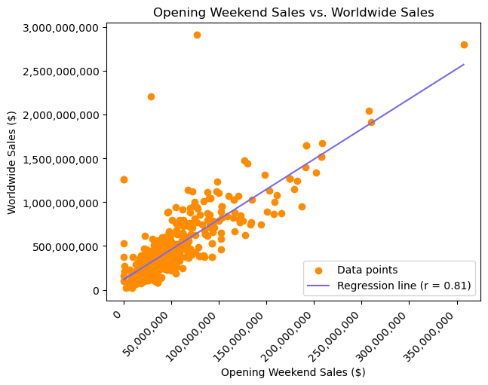
Opening Weekend Sales vs Worldwide Sales
H₀: There is no correlation between a movie’s opening weekend sales and worldwide sales→REJECT
Profitability of opening weekend sales and worldwide sales are positively correlated
r-value (.81) shows strong correlation and p-value (1.17e-107)<.05 indicates stat. sig.
→ REJECT H₀
Notes:
r-value = 0.81 indicates strong positive correlation
p-value = 1.17e-107 < .05 benchmark, meaning we reject the null hypothesis
The correlation is strong and the statistical analysis confirms that movies with higher opening weekend sales tend to have higher worldwide sales

Slide 13
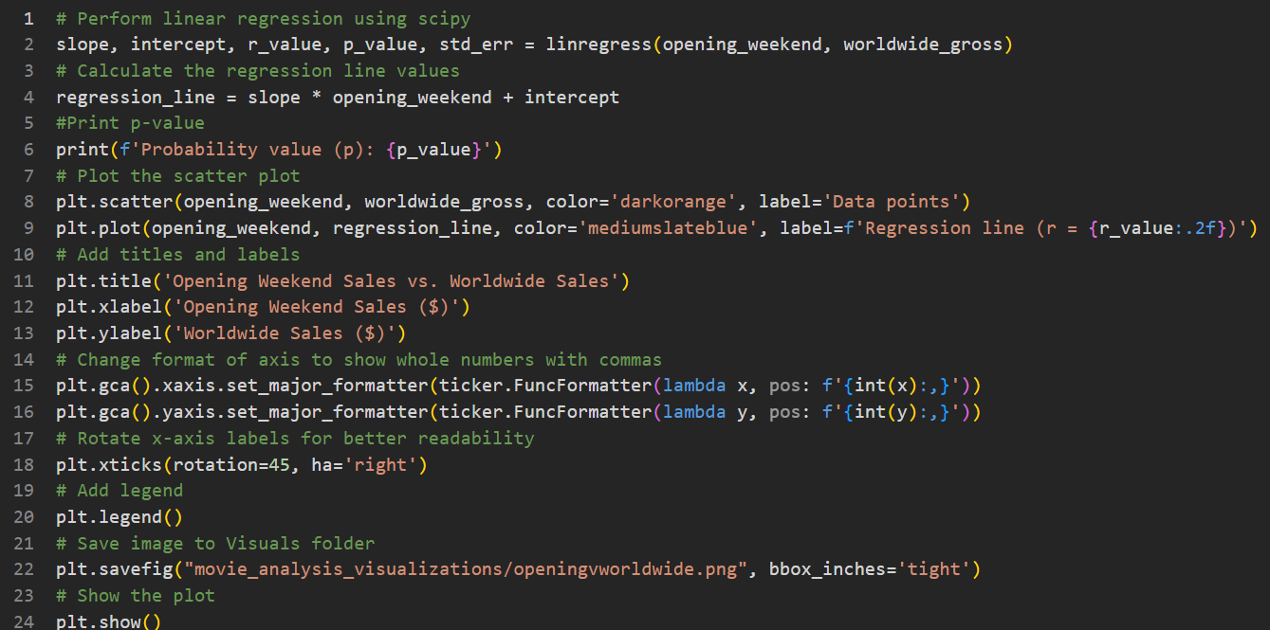
Opening Weekend Sales vs Worldwide Sales
CODE SNIPPET
Notes:
r-value = 0.81 indicates strong positive correlation
p-value = 1.17e-107 < .05 benchmark, meaning we reject the null hypothesis
The correlation is strong and the statistical analysis confirms that movies with higher opening weekend sales tend to have higher worldwide sales

Slide 14

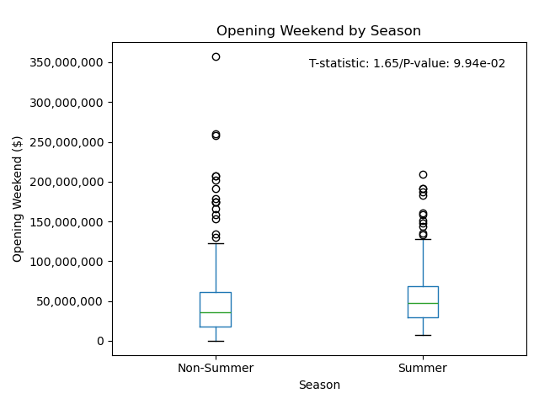
Opening Weekend Sales by Season
H₀: Summer movies do not have higher opening weekend sales compared to non-summer movies→FAIL TO REJECT
Difference in opening weekend sales between summer and non-summer months is not statistically significant
t-stat (1.65)=critical value (1.646) and p-value (.099)>.05 indicate no stat. sig. difference
→ FAIL TO REJECT H₀

Slide 15
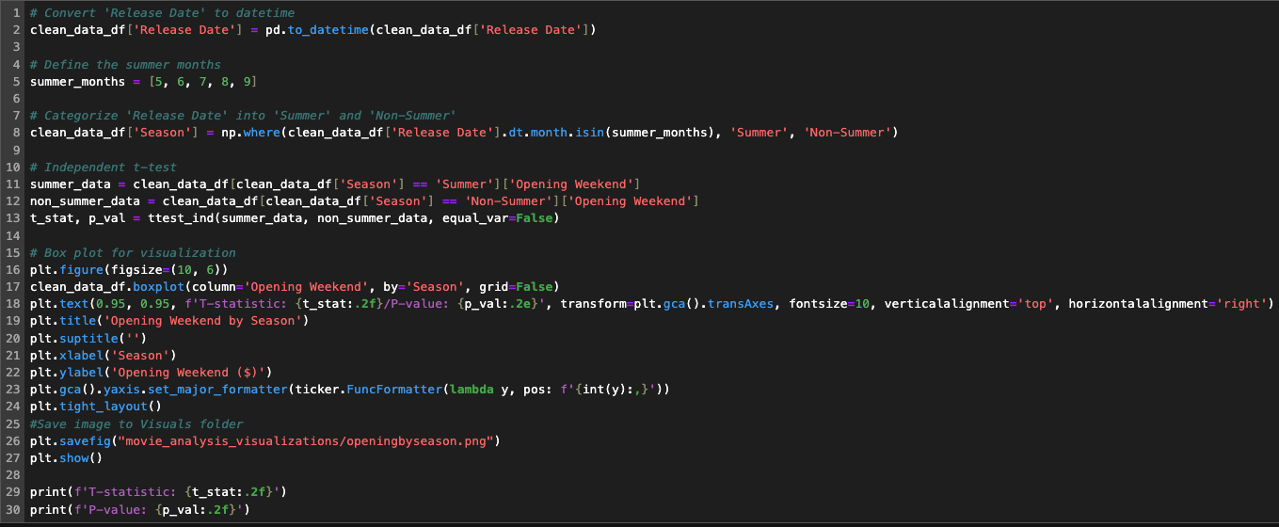
Opening Weekend Sales by Season
CODE SNIPPET
Notes:
Our fourth hypothesis posited that the release date significantly influences a movie’s opening weekend sales, with the expectation that summer movies would perform better. This hypothesis stems from the belief that movie attendance peaks during the summer. Our null hypothesis was that there is no difference in opening weekend sales between summer and non-summer movies.
With a p-value of 0.0994, which is greater than our benchmark of 0.05, the results are not statistically significant, leading us to fail to reject the null hypothesis. However, the independent t-test reveals a t-statistic of 1.65 and a p-value of 0.0994, suggesting a trend that summer movies might have higher opening weekend sales compared to non-summer movies. This trend, while not significant, is close to the threshold and indicates that further investigation with a larger sample size or additional data could be valuable.
The results imply that other factors beyond the release season may play a crucial role in determining opening weekend sales. These factors could include marketing efforts, competition from other films, franchise popularity, and star power. Therefore, while summer release dates alone do not guarantee higher sales, a comprehensive strategy that leverages these additional factors might be essential for maximizing opening weekend performance.

Slide 16

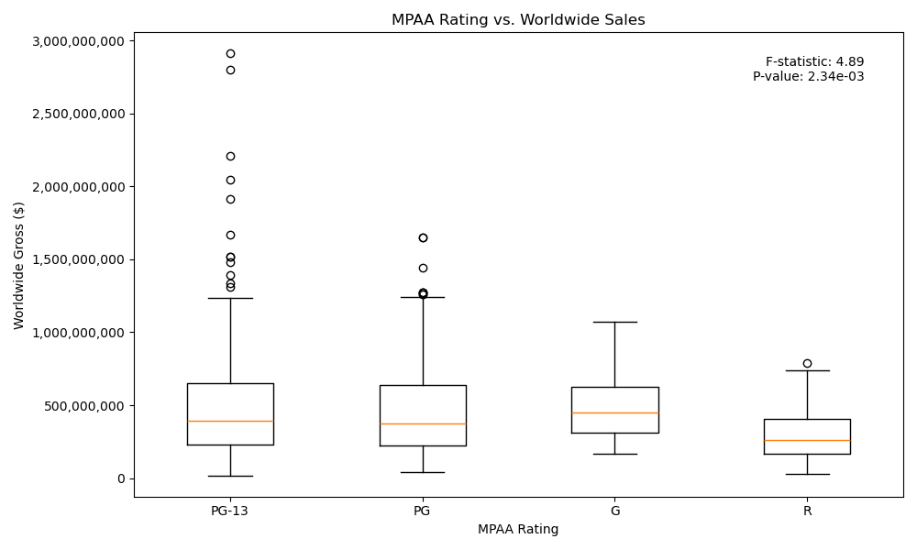
MPAA Rating vs. Worldwide Sales
H₀: There is no difference in worldwide sales when it comes to a movie’s MPAA Rating→REJECT
Difference in worldwide sales between MPAA rating is statistically significant
f-stat (4.89) exceeds critical value (2.605) and p-value (.002) <.05 indicate signifcant difference
→ REJECT H₀
Notes:
p-value = .002 < .05 benchmark, meaning we reject the null hypothesis
f-statistic = 4.89 > 2.604 f-critical value
The statistically significant f-statistic and p-value indicate that MPAA ratings directly impact worldwide sales. Studios can leverage this insight for strategic decision-making in movie production, marketing, and distribution to maximize their financial returns.

Slide 17
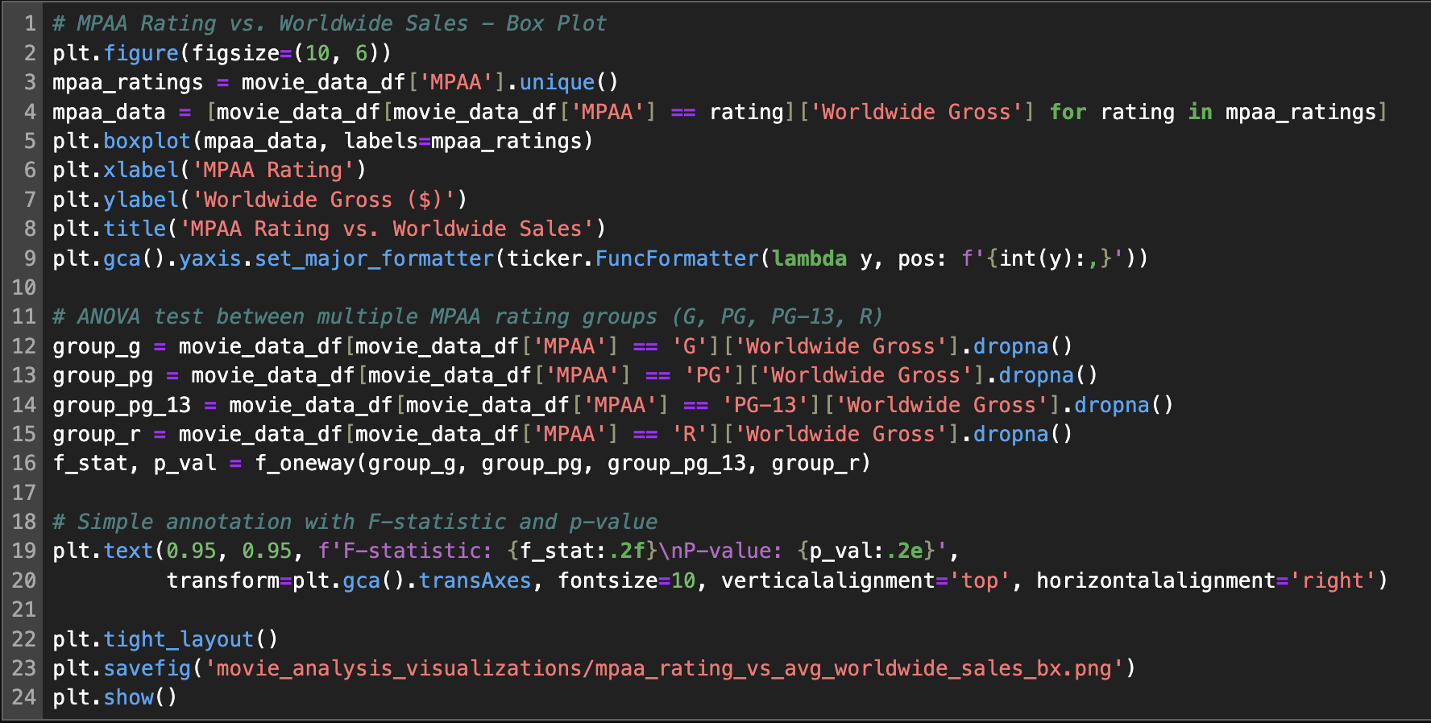
MPAA Rating vs. Worldwide Sales
CODE SNIPPET
Notes:
p-value = .002 < .05 benchmark, meaning we reject the null hypothesis
f-statistic = 4.89 > 2.604 f-critical value
The statistically significant f-statistic and p-value indicate that MPAA ratings directly impact worldwide sales. Studios can leverage this insight for strategic decision-making in movie production, marketing, and distribution to maximize their financial returns.

Slide 18

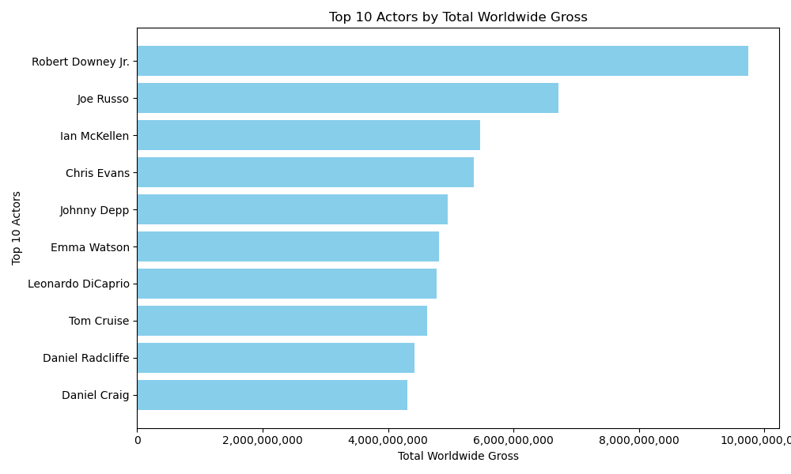
Top 10 Actors by Total Worldwide Gross
The top 3 thru 10 actors are relatively close in the total worldwide gross values they bring in.
The total worldwide gross value jumps 20.34% from Ian McKellen (#3) to Joe Russo (#2).
The total worldwide gross value jumps 36.89% from Joe Russo (#2) and Robert Downey Jr. (#1)

Slide 19
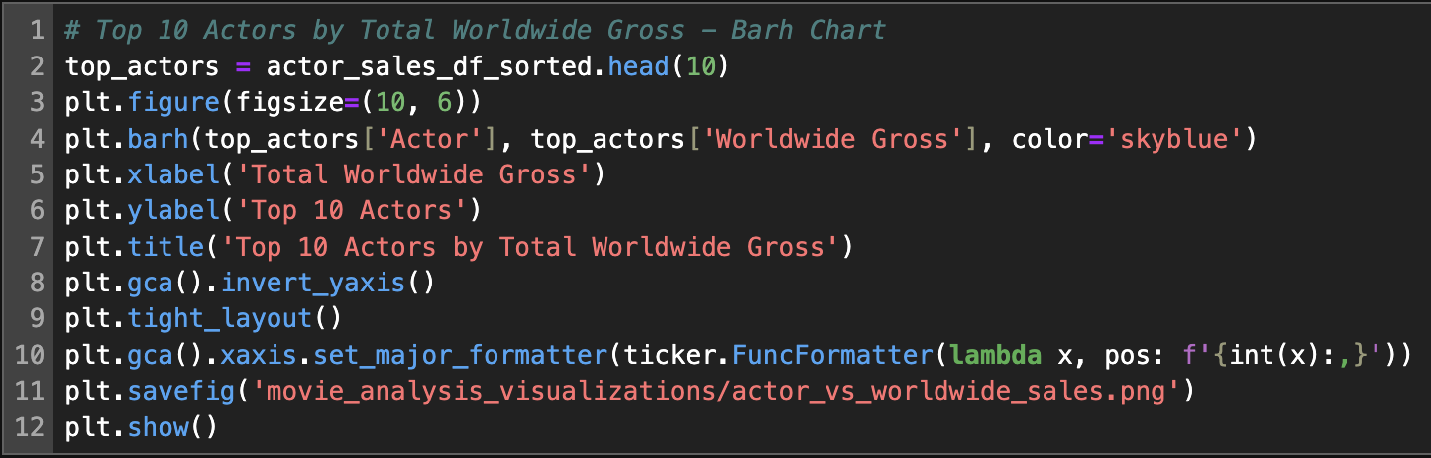
Top 10 Actors by Total Worldwide Gross
CODE SNIPPET

Slide 20

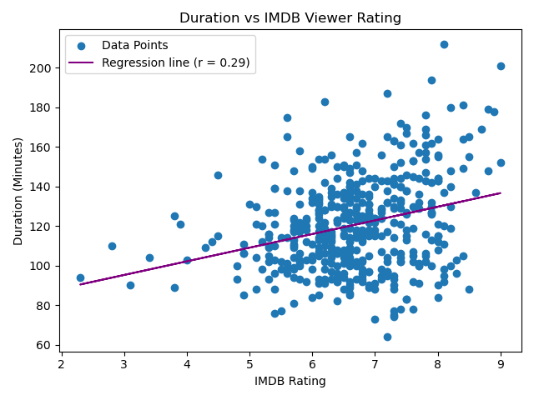
Duration vs IMDB Viewer Rating
Movies with higher IMDB ratings tend to have longer durations
r-value (0.29) means weak correlation, but p-value (3.17e-10)<.05 indicates statistical significance
Notes:
r-value = 0.29 indicates weak positive correlation
p-value = 3.17e-10 < .05 benchmark
Though the correlation is weak, the statistical analysis confirms that movies with higher IMDB ratings tend to have longer durations.

Slide 21
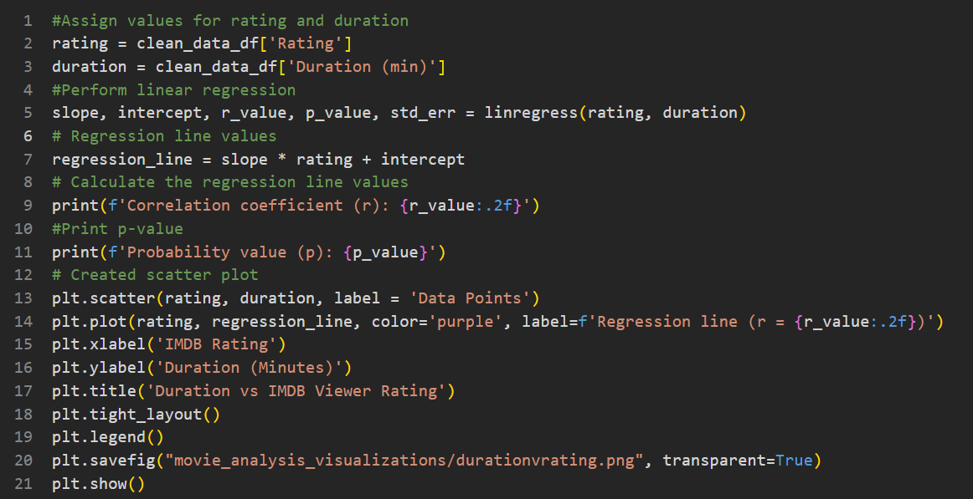
Duration vs IMDB Viewer Rating
CODE SNIPPET
Notes:
r-value = 0.29 indicates weak positive correlation
p-value = 3.17e-10 < .05 benchmark
Though the correlation is weak, the statistical analysis confirms that movies with higher IMDB ratings tend to have longer durations.

Slide 22

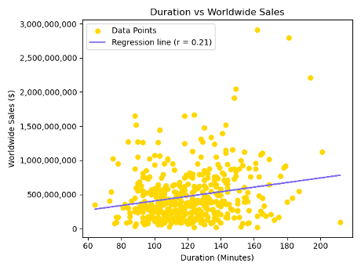
Duration vs Worldwide Sales
Movies with higher IMDB ratings tend to have higher worldwide sales
r-value (0.21) shows weak correlation, but p-value (6.8e-06)<.05 indicates statistical significance
Notes:
r-value = 0.21 indicates weak positive correlation
p-value = 6.8e-06 < .05 benchmark
Though the correlation is weak, the statistical analysis confirms that movies with higher IMDB ratings tend to have higher worldwide sales

Slide 23
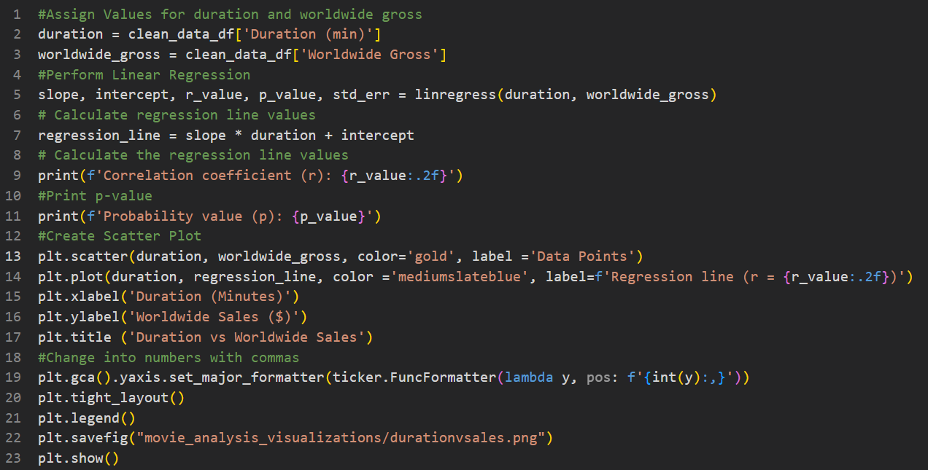
Duration vs Worldwide Sales
CODE SNIPPET
Notes:
r-value = 0.21 indicates weak positive correlation
p-value = 6.8e-06 < .05 benchmark
Though the correlation is weak, the statistical analysis confirms that movies with higher IMDB ratings tend to have higher worldwide sales

Slide 24

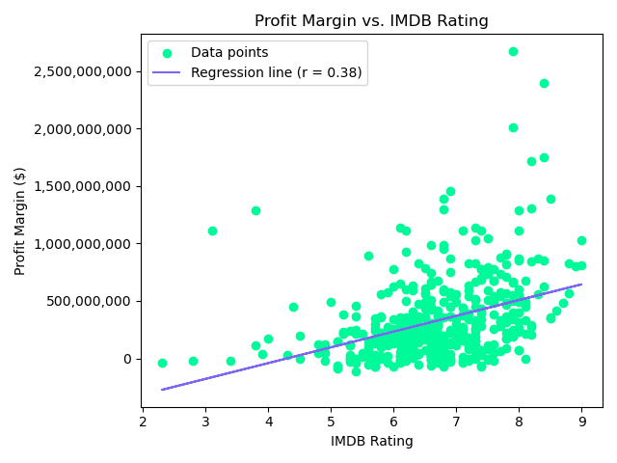
Profit Margin vs. IMDB Rating
Movies with higher IMDB ratings tend to have higher profit margins
r-value (0.38) shows moderate correlation and p-value (4.82e-17)<.05 indicates statistical significance

Slide 25
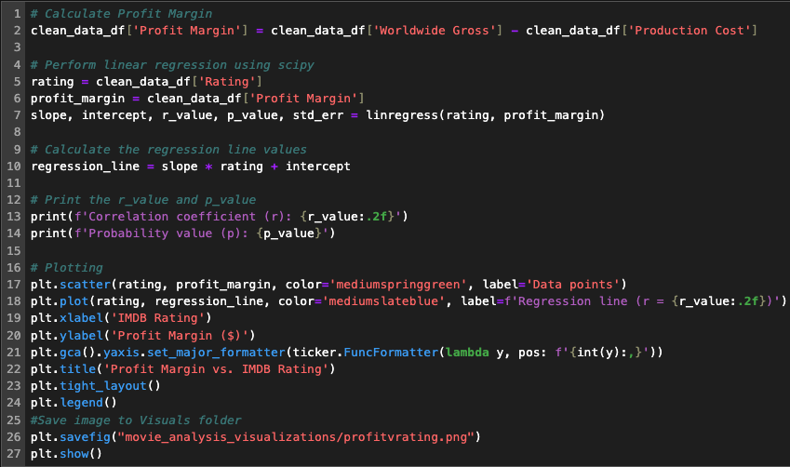
Profit Margin vs. IMDB Rating
CODE SNIPPET
Notes:
In the graph above, IMDB ratings are shown to be a strong indicator of a movie's profit margin, as evidenced by a p-value of 4.82e-17. This statistically significant relationship suggests that higher IMDB ratings are associated with higher profit margins. For movie executives, this implies the importance of positive reviews and high visibility on streaming platforms and press outlets.
Positive press and high visibility on streaming platforms can contribute to higher IMDB ratings. When viewers see a movie that has been favorably reviewed or recommended by movie reporters, they are more likely to watch it and subsequently rate it positively on IMDB. This positive feedback loop can help maintain a movie's popularity and profitability.
Therefore, strategic efforts to generate favorable reviews and maximize exposure on streaming platforms and press outlets can have a significant impact on a movie’s financial success. Movie executives should focus on these areas to ensure their films receive positive attention, which in turn can drive higher IMDB ratings and increase profit margins.

Slide 26

Numerical Summary
Hypothesis | P-Value | R-Value | T-Statistic | F-Statistic | Null Hypothesis Determination
Production Cost vs. Worldwide Sales | 3.29e-38 | .55 | N/A | N/A | Reject
Genre vs. Profit Margin | .005 | N/A | N/A | 2.75 | Reject
Opening Weekend vs. Worldwide Sales | 1.17e-107 | .81 | N/A | N/A | Reject
Opening Weekend by Season | .0994 | N/A | 1.65 | N/A | Fail to Reject
MPAA Rating vs. Worldwide Sales | .00234 | N/A | N/A | 4.89 | Reject

Slide 27

Conclusions
The factors that have the most impact on the success of movies are:
MPAA Rating and Audience Engagement
The significant influence of MPAA Rating on worldwide sales (p = 0.00234) displays audience preferences and viewing demographics. Movies with less restrictive ratings attract wider audiences, including families and younger viewers, translating into higher ticket sales globally.
A Successful Opening Weekend and a Profitable Genre
The strong correlation (r = .81) between a movie’s opening weekend and its total worldwide sales demonstrated the importance of a profitable opening weekend. At the same time, genres like Comedy, Action, Adventure, and Black Comedy have higher profits.
Production Costs and Profitability Across Genres
While higher production costs generally lead to higher worldwide sales, the degree of this correlation changes across genres. Action and Adventure genres, known for their big production budgets, show significant returns on investment. However, the moderate positive correlation (r = 0.55) suggests that production costs are not the determining factor in guaranteeing a movie’s success

Slide 28
Implications
Because there is such a strong correlation between Opening Weekend Sales and Worldwide Gross, movie execs should put considerable resources into marketing with a focus on the opening weekend.
Since Genres like Comedy, Action, Adventure, and Black Comedy have higher profits, movie execs should leverage this information to focus on producing movies in these categories.
Data surrounding popular actors can be leveraged to strategically give certain actors certain roles to boost profits. This insight prompts movie execs to balance investment in production with genre-specific market research to ensure profitability.
Studios can leverage MPAA ratings as a strategic tool in content development and marketing, ensuring alignment with audience preferences to enhance commercial success.

Slide 29


